Slide 1
In-Browser Raster Data Processing
Vishnu Raj Cherukudi Mattuvayil

Slide 2
Introduction
What is raster data?
What is Web Assembly(Wasm)?
Why use Wasm for this project?

Slide 3
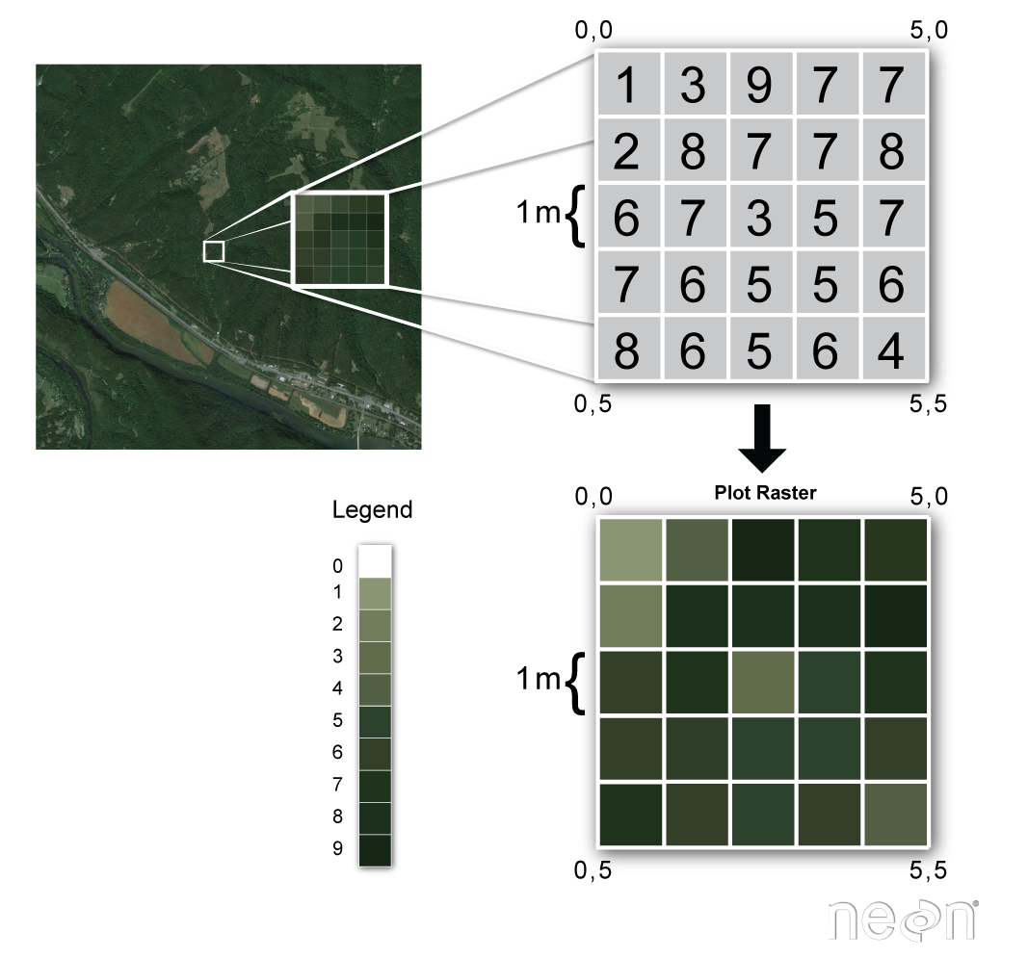
Raster Data
Type of spatial data.
Data from satellites.
Represented as multi-dimensional arrays.
Datasets from CDS.

Slide 4
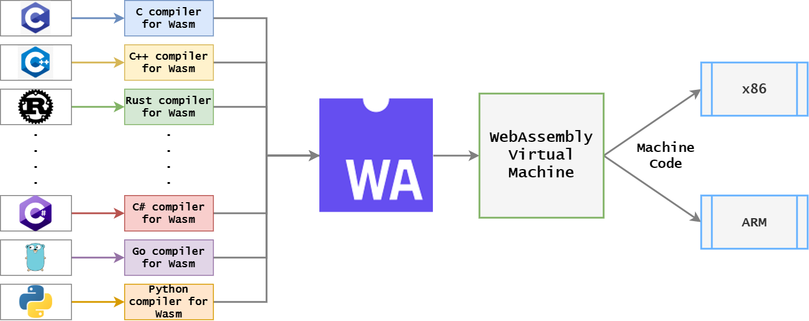
Web Assembly
It is a byte code instruction format.
Linked together with JS and HTML.
Can be run on modern browser.
Achieves near native performance.
Polyglot.

Slide 5
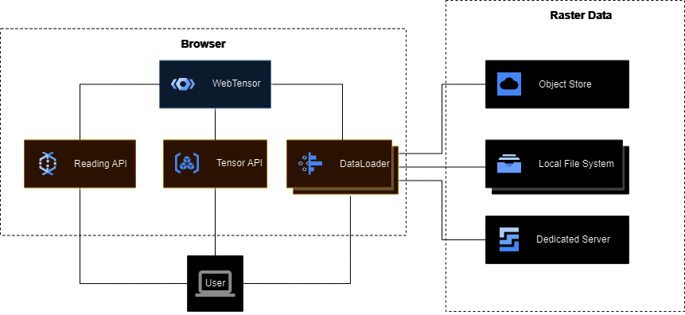
Implementation
Data loader.
Raster data processing module or WebTensor.
User Interface for visualization.

Slide 6
Data Loader
Parquet-Wasm
Coordinate Reference System(CRS) Type
Spatial Extent
Band Selection
Chunk Size

Slide 7

User Interface
Histograms
Min and Max values

Slide 8



Tools
Emscripten for C/C++.
Pyodide for python.
Geospatial Data Abstraction Library(GDAL).
Xarray.

Slide 9
Benchmarking
Implement the same program without wasm.
Compare and measure the performance.

Slide 10
References
[1] L. F. Naumann, “WebTensor: Towards high-performance raster data analysis in the browser,” in Datenbanksysteme für Business, Technologie und Web (BTW 2023), 20. Fachtagung des GIFachbereichs „Datenbanken und Informationssysteme" (DBIS), 06.-10, März 2023, Dresden, Germany, Proceedings, vol. P-331 of LNI, pp. 1083–1089, Gesellschaft für Informatik e.V., 2023.
[2] S. Singla, A. Eldawy, T. Diao, A. Mukhopadhyay, and E. Scudiero, “Experimental study of big raster and vector database systems,” in 2021 IEEE 37th International Conference on Data Engineering (ICDE), pp. 2243–2248, 2021.

Slide 11
Thank you!
vishnu-raj.cherukudi-mattuvayil@tu-ilmenau.de | www.tu-ilmenau.de

